Slide 1
Analyzing the Impact of Car Features on Price and Profitability
Project no. 7 :- USING EXCEL STATISTICS

Slide 2
PROJECT DESCRIPTION
This project aims to harness data analysis techniques to empower car manufacturers in the automotive industry to optimize pricing strategies and guide product development decisions.
By analyzing a comprehensive dataset encompassing car features, market categories, pricing, and consumer preferences, the project seeks to identify key factors driving consumer demand and profitability.
Through regression analysis, market segmentation, and machine learning algorithms, the project will uncover insights into consumer behavior, price elasticity, and market dynamics.
These insights will inform the development of data-driven pricing models tailored to different market segments, as well as recommendations for product enhancements and innovation strategies to meet evolving consumer expectations.
Ultimately, the project endeavors to equip car manufacturers with the actionable insights needed to maximize profitability while effectively satisfying consumer demand in a rapidly evolving automotive landscape.

Slide 3
OBJECTIVES
Analyzing Car Features: Explore the relationship between various car features such as engine power, transmission type, and number of cylinders with their corresponding prices and profitability metrics to identify influential factors.
Market Category Analysis: Investigate how the popularity of car models varies across different market categories to understand consumer preferences and inform product development strategies.
Price Optimization: Utilize regression analysis techniques to determine the significance of different car features in determining the final price, enabling the development of pricing strategies that balance consumer demand with profitability.
Manufacturer Comparison: Compare the average prices of cars across different manufacturers to identify trends and variations, providing insights into competitive positioning and market dynamics.
Fuel Efficiency Investigation: Analyze the relationship between fuel efficiency metrics and engine specifications such as the number of cylinders to understand consumer preferences and market trends, guiding future product development efforts.

Slide 4
APPROACH & TECH STACK & TASKS
The focus is particularly on data cleaning and preprocessing to handle missing values, outliers in the dataset ensuring the reliability and accuracy of the dataset.
Perform Exploratory Data Analysis (EDA) on the cleaned dataset.
After that the required analysis will be done resulting in creating the dashboard.
TECH-STACK USED: MS EXCEL , VISUALIAZATION.
TASKS :- 1. ANALYSIS.
2. BUILDING A DASHBOARD.

Slide 5
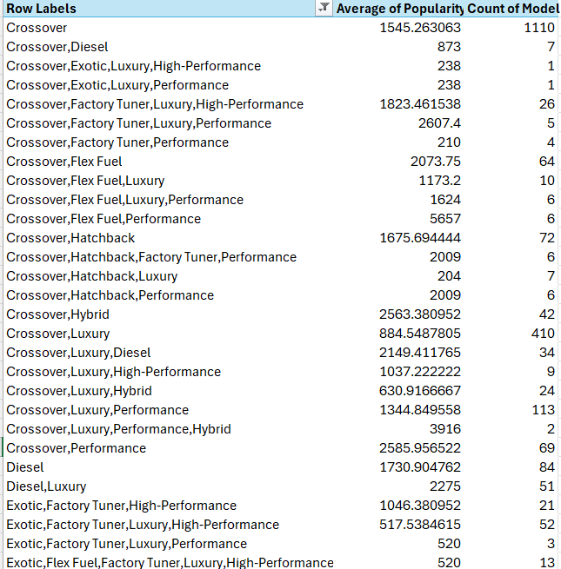
ANALYSIS TASK 1A & INSIGHT
Task 1.A: Create a pivot table that shows the number of car models in each market category and their corresponding popularity scores.
Insight Required: How does the popularity of a car model vary across different market categories?
Result: The popularity of a car model can vary across different market categories based on various factors. Generally, the popularity of a car model may be influenced by factors such as consumer preferences, market demand, price range, and target audience within each market category. Such insights can guide manufacturers and marketers in developing and positioning their car models to effectively cater to the specific preferences and demands of each market segment.

Slide 6
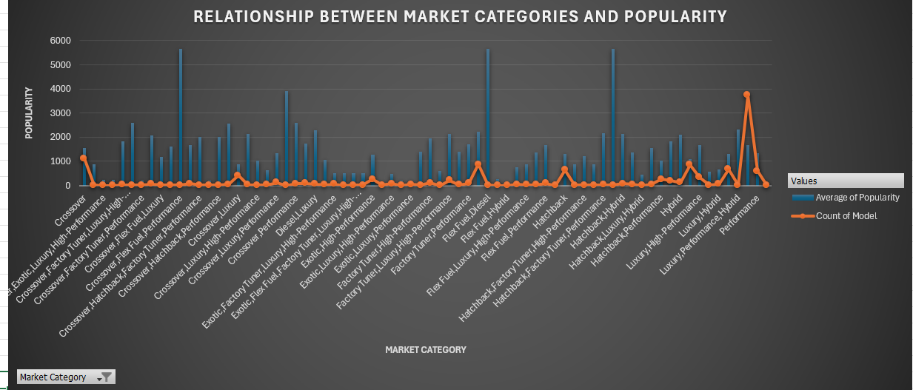
ANALYSIS TASK 1B
Task 1.B: Create a combo chart that visualizes the relationship between market category and popularity.

Slide 7
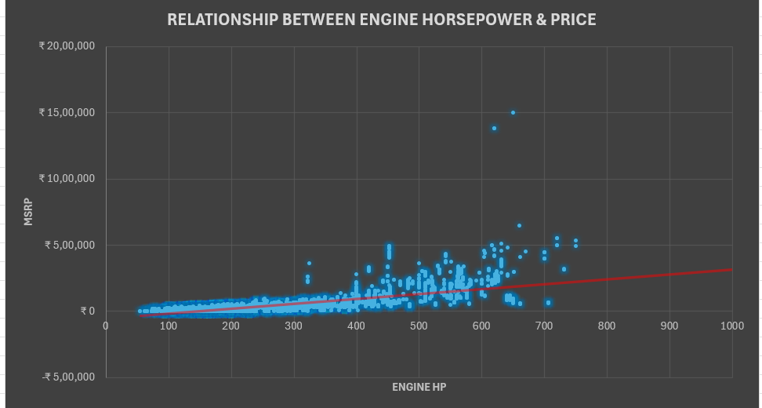
ANALYSIS TASK 2
Create a scatter chart that plots engine power on the x-axis and price on the y-axis. Add a trendline to the chart to visualize the relationship between these variables.

Slide 8
ANALYSIS TASK 2 - INSIGHT
Insight Required: What is the relationship between a car's engine power and its price?
Result: The relationship between a car's engine power and its price can vary depending on several factors. In general, there is often a positive correlation between engine power and price, meaning that as engine power increases, the price of the car tends to increase as well. This is because higher engine power often requires more advanced technology, engineering, and components, which can drive up production costs and, subsequently, the price of the vehicle.

Slide 9
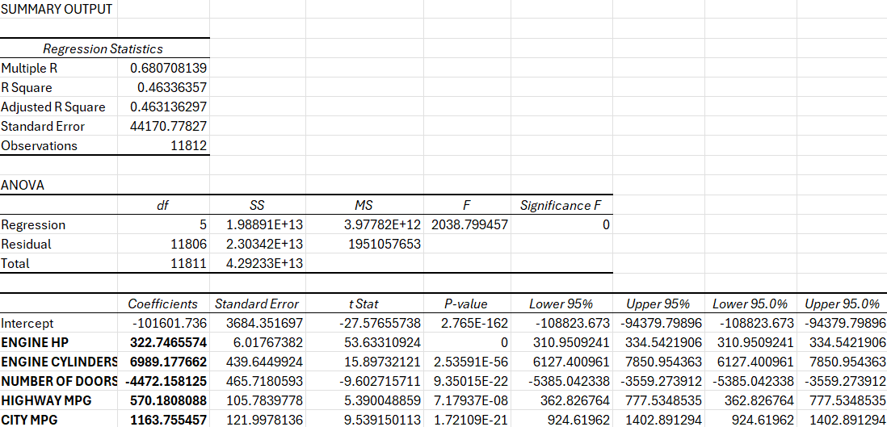
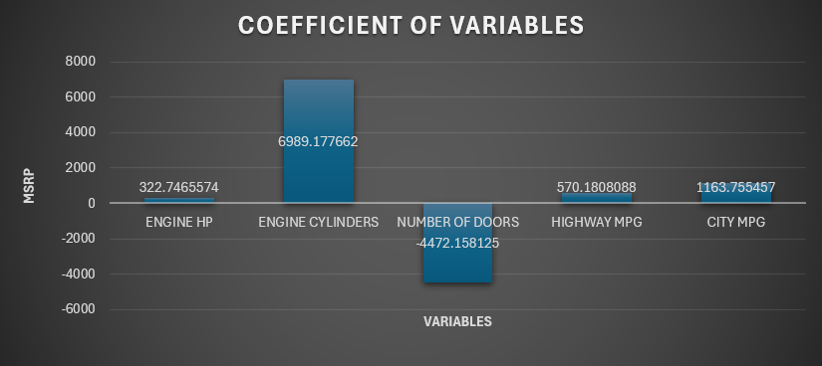
ANALYSIS TASK 3
Use regression analysis to identify the variables that have the strongest relationship with a car's price. Then create a bar chart that shows the coefficient values for each variable to visualize their relative importance.

Slide 10
ANALYSIS TASK 3 - INSIGHT
To identify the variables that have the strongest relationship with a car's price, regression analysis can be employed. This statistical technique analyzes the relationship between a dependent variable and independent variables. By conducting regression analysis, the coefficient values for each variable can be obtained, indicating the strength and direction of their impact on the car's price.
Insight Required: Which car features are most important in determining a car's price?
Result: From the above analysis, I can be seen that Engine Cylinders followed by City MPG and Highway MPG are the most important points that determine the price of a car.

Slide 11
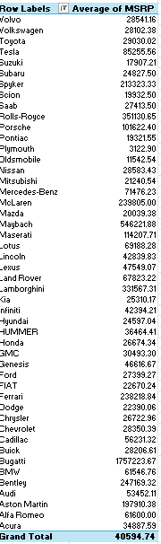
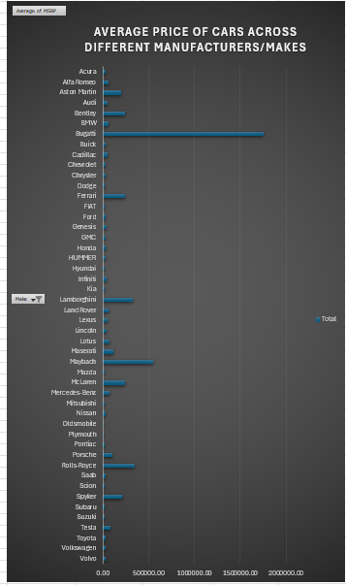
ANALYSIS TASK 4A & 4B
Task 4.A: Create a pivot table that shows the average price of cars for each manufacturer.
Task 4.B: Create a bar chart or a horizontal stacked bar chart that visualizes the relationship between manufacturer and average price

Slide 12
ANALYSIS TASK 4A & 4B - INSIGHT
Insight Required: How does the average price of a car vary across different manufacturers?
Result: The average price of a car can vary significantly across different manufacturers. Each manufacturer has its own pricing strategy, target market, brand positioning, and product offerings, which contribute to the variations in average prices.
Luxury and high-end manufacturers often have higher average prices due to their focus on premium features, advanced technology, and superior craftsmanship. These brands cater to consumers seeking exclusivity, prestige, and top-tier performance, which comes with a higher price tag.
On the other hand, mainstream manufacturers typically offer a wider range of vehicles at various price points to target different segments of the market. Their average prices can vary depending on factors such as vehicle size, model type, features, and market competition. Economy or budget-oriented brands often have lower average prices as they prioritize affordability and cost-effectiveness

Slide 13
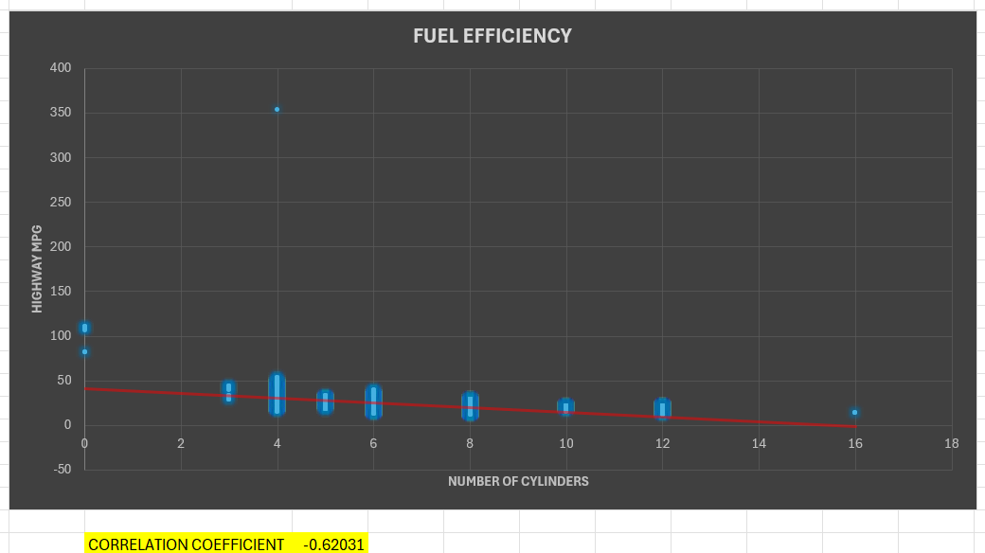
ANALYSIS TASK 5A & 5B
Task 5.A: Create a scatter plot with the number of cylinders on the x-axis and highway MPG on the y-axis. Then create a trendline on the scatter plot to visually estimate the slope of the relationship and assess its significance.
Task 5.B: Calculate the correlation coefficient between the number of cylinders and highway MPG to quantify the strength and direction of the relationship

Slide 14
ANALYSIS TASK 5A & 5B - INSIGHT
Insight Required: What is the relationship between fuel efficiency and the number of cylinders in a car's engine?
Result: The relationship between the number of cylinders in a car's engine and fuel efficiency, which is frequently expressed in terms of miles per gallon or MPG, can be complicated and influenced by a variety of factors. Moreover, a higher cylinder count typically leads to a worse fuel efficiency. This is true because more cylinders often result in greater power and performance, but they also consume more gasoline to run. Adding more cylinders frequently results in higher fuel usage, which lowers a vehicle's overall MPG.
In comparison to larger engines with more cylinders, such 6-cylinder or 8-cylinder engines, smaller engines with fewer cylinders, like 4-cylinder engines, frequently have a higher fuel efficiency. This is so because smaller engines use less fuel to produce the same amount of power due to their reduced displacement.

Slide 15
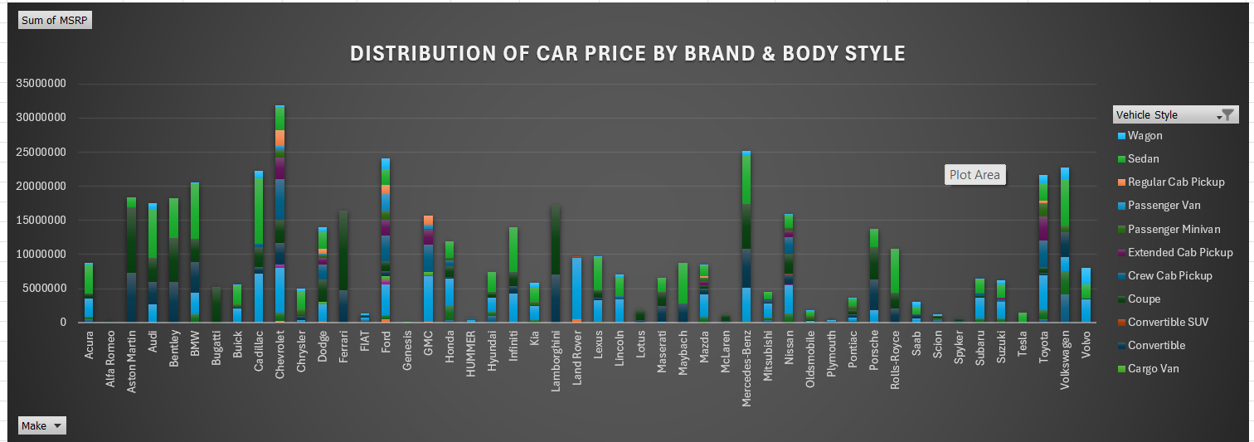
DASHBOARD TASK 1
Task 1: How does the distribution of car prices vary by brand and body style?
Hints: Stacked column chart to show the distribution of car prices by brand and body style. Use filters and slicers to make the chart interactive. Calculate the total MSRP for each brand and body style using SUMIF or Pivot Tables.

Slide 16
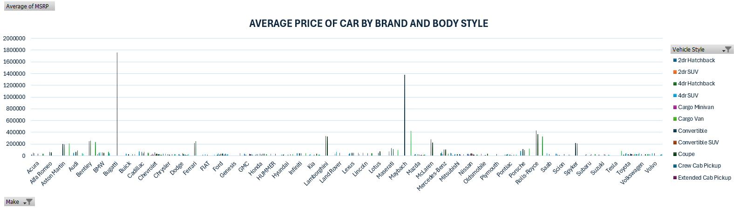
DASHBOARD TASK 2
Task 2: Which car brands have the highest and lowest average MSRPs, and how does this vary by body style?
Hints: Clustered column chart to compare the average MSRPs across different car brands and body styles. Calculate the average MSRP for each brand and body style using AVERAGEIF or Pivot Tables.

Slide 17
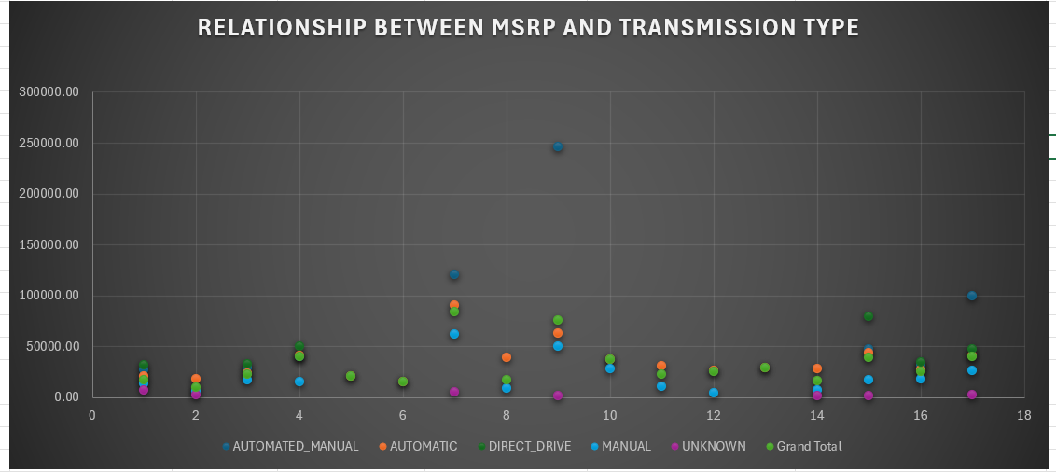
DASHBOARD TASK 3
Task 3: How do the different feature such as transmission type affect the MSRP, and how does this vary by body style?
Hints: Scatter plot chart to visualize the relationship between MSRP and transmission type, with different symbols for each body style. Calculate the average MSRP for each combination of transmission type and body style using AVERAGEIFS or Pivot Tables

Slide 18
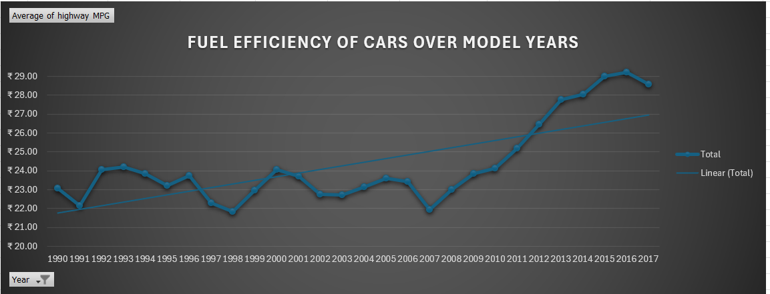
DASHBOARD TASK 4
Task 4: How does the fuel efficiency of cars vary across different body styles and model years?
Hints: Line chart to show the trend of fuel efficiency (MPG) over time for each body style. Calculate the average MPG for each combination of body style and model year using AVERAGEIFS or Pivot Tables.

Slide 19
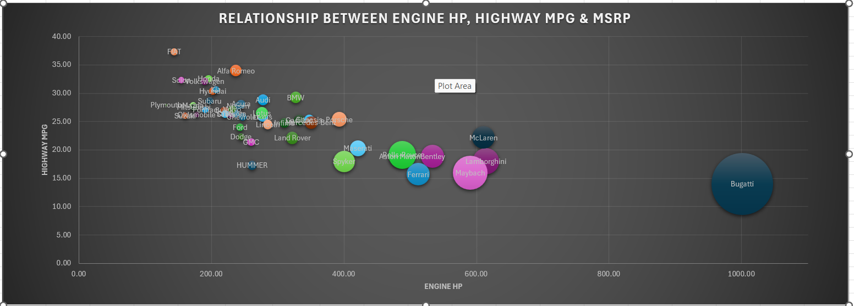
DASHBOARD TASK 5
Task 5: How does the car's horsepower, MPG, and price vary across different Brands?
Hints: Bubble chart to visualize the relationship between horsepower, MPG, and price across different car brands. Assign different colors to each brand and label the bubbles with the car model name. Calculate the average horsepower, MPG, and MSRP for each car brand using AVERAGEIFS or Pivot Tables.

Slide 20
INSIGHTS
The project focuses on creating dashboards to provide insights into profitable pricing and product development decisions for vehicle manufacturers while meeting consumer demand.
By examining MPG factors in the dataset, the analysis helps consumers make informed vehicle purchase decisions by identifying energy-efficient car categories, promoting sustainability, and cost savings.
Utilizing dataset properties and market category variables, a predictive model for car prices is developed, aiding manufacturers and consumers in understanding how different features influence automobile costs and informing pricing strategies.
The dataset serves as a valuable resource for data analysts interested in exploring various aspects of the automobile sector, providing insights for product development, marketing strategies, and pricing tactics.

Slide 21
CONCLUSION
Impactful Data Analysis Techniques: Mastery of regression analysis, pivot tables, sensitivity analysis, optimization, and time series analysis enables data analysts to provide invaluable insights to vehicle manufacturers, aiding in effective decision-making regarding product development and pricing strategies.
Key Insights for Decision-Making: Understanding market dynamics, engine power's influence on price, variables affecting car pricing, fuel economy variations across brands and body types, and gearbox types' impact on MSRP are crucial insights for manufacturers to tailor their offerings, target diverse market segments, and stay competitive in the automotive industry.
GOOGLE DRIVE – PRESENTATION FILES – LINK
VIDEO LINK
GOOGLE DRIVE – ANALYSIS FILE – LINK
EXCEL LINK

Slide 22
THANK YOU.

